Slide 1
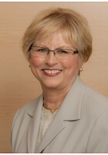
Conference Co-chairs
Janet Deatrick, PhD, FAAN
deatrick@nursing.upenn.edu
Kathleen Knafl, PhD, FAAN
kknafl@email.unc.edu

Slide 2
IFNA office / Conference website
The IFNA Administrative Office is always able to offer assistance, or answer any questions.
Debbie Zaparoni
debbie@internationalfamilynursing.org
Visit the IFNA Website frequently for
Conference Updates
http://internationalfamilynursing.org/2013/07/11/2015-conference/

Slide 3
Conference Overview
Theme: Improving Family Health Globally through Research, Education, and Practice
Dates: August 18-21, 2015
Setting: Odense Denmark – train ride from Copenhagen airport
Venue: Radisson Blu Hotel – Odense

Slide 4
Important Dates
September 8th 11am EDT – (Webinar) Abstract Submission Support
An informational webinar to help you submit a successful abstract
September 15 – October 15 – Call for Pre-Conference Workshops / Expert Lectures
October 1 to November 24 – Call for Abstracts for podium / poster presentations
January, 2015 – Notification of Abstract submission status
February / March, 2015 – Conference registration opens

Slide 5
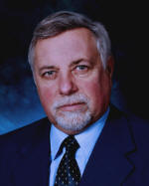
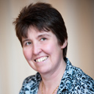
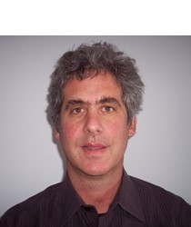
Conference Preview
Keynote Speakers
Kenneth J. Doka – Family involvement in end-of-life and palliative care
Alison Metcalfe – Family communication regarding genetic risk
Stevan M. Weine – Family interventions for immigrants & survivors of political trauma

Slide 6
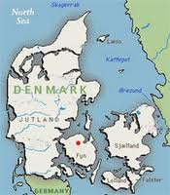
Special Events
Opening reception – Odense City Hall
Gala dinner – Renovated 13th century castle

Slide 7
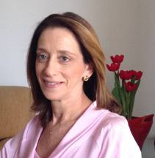
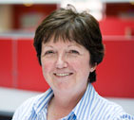
Country Liaison Coordinators
Jane Lassetter, Brigham Young University, USA
Jane_lassetter@byu.edu
Regina Bousso, University of Sao Paulo, Brazil
szylit@usp.br
Veronica Swallow, University of Manchester, UK
Veronica.swallow@manchester.ac.uk

Slide 8
Country Liaisons’ Responsibilities
Disseminate information about the IFNA Conference
Disseminate information about abstracts
Abstracts can be submitted Oct 1 to Nov 24, 2014
Free webinar for all on abstract format and submission:
September 8th at 11 a.m. Eastern US time (New York City)
Please register for the webinar at https://www3.gotomeeting.com/register/376140222.
Webinar will be freely available afterward to IFNA members and nonmembers at http://internationalfamilynursing.org/

Slide 9
Country Liaisons’ Benefits
Your Benefits
Official Letter of appointment to be a Country Liaison
Can be helpful with advancement and tenure
Can be helpful with securing your own funds for the conference
Professional development opportunity
Increased visibility of your organization
Recognized at the conference
IFNA Benefits
Country Liaisons are key to the success of the IFNA Conference
Disseminate information
Encourage participation
Answer questions
Welcome attendees

Slide 10
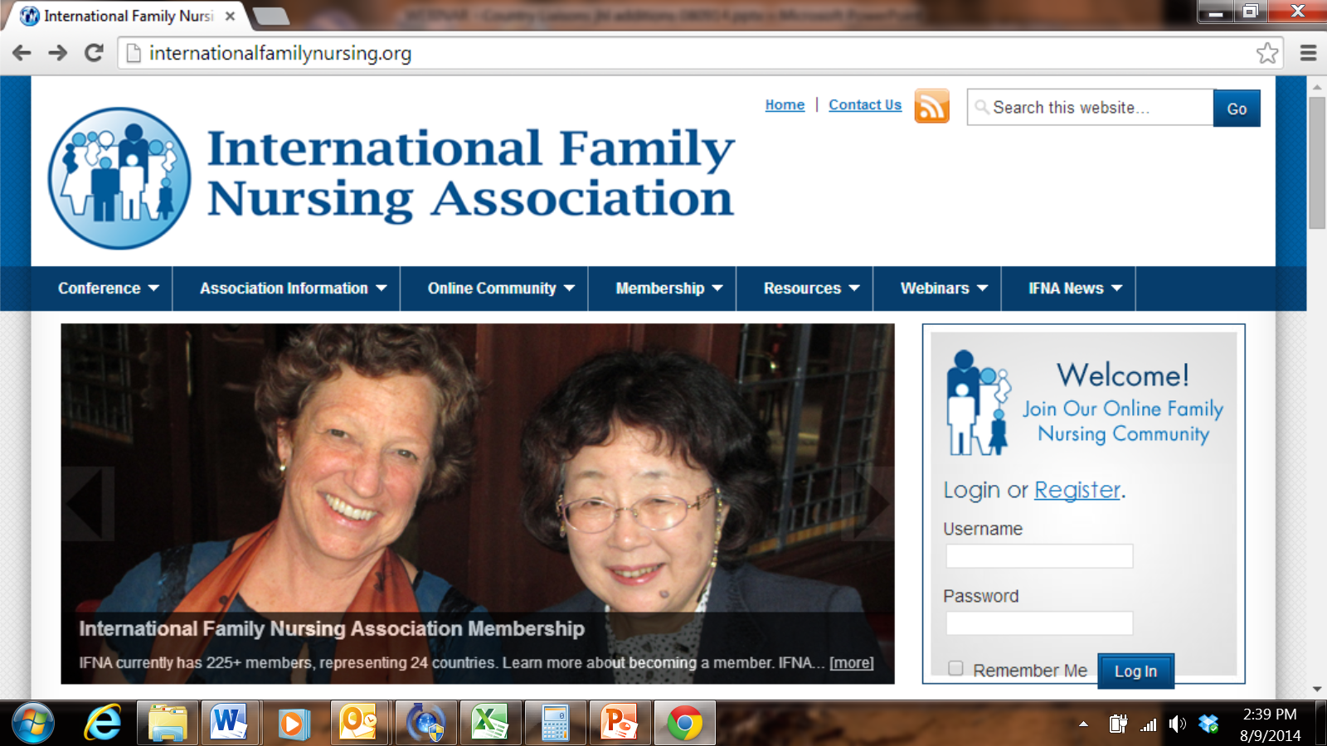
Membership Requirement for Country Liaisons
Country Liaisons need to be current IFNA members
If you will be a new IFNA member or if your membership has lapsed:
Join IFNA at http://internationalfamilynursing.org/
Click on the “Membership” tab & select “become a member” to apply
Create your Online Community Profile, under the “Online Community” tab to start a forum within the IFNA membership.
Contact Debbie Zaparoni if you need any assistance.
debbie@internationalfamilynursing.org

Slide 11
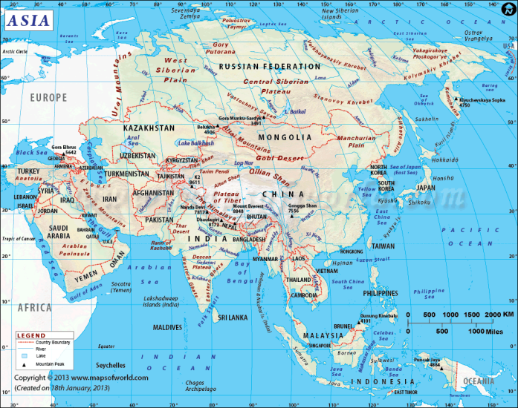
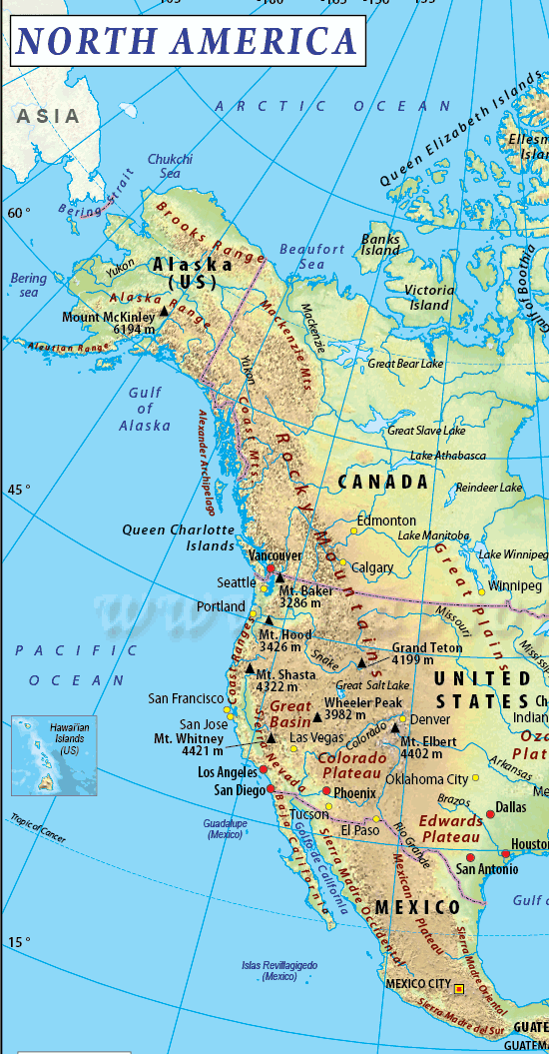
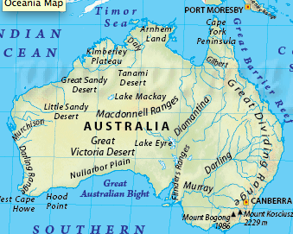
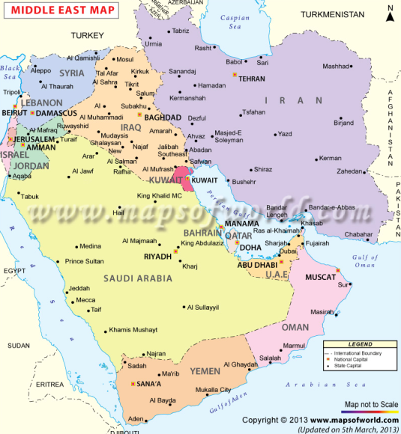
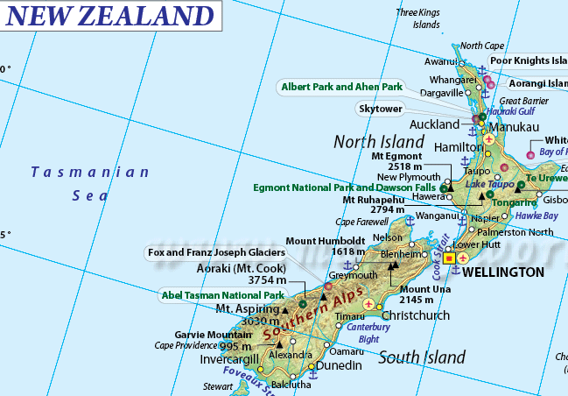
Jane Lassetter jane_lassetter@byu.edu
North America (Canada, USA, Mexico)
Middle East
Asia
Australia
New Zealand
Regional Breakdown

Slide 12
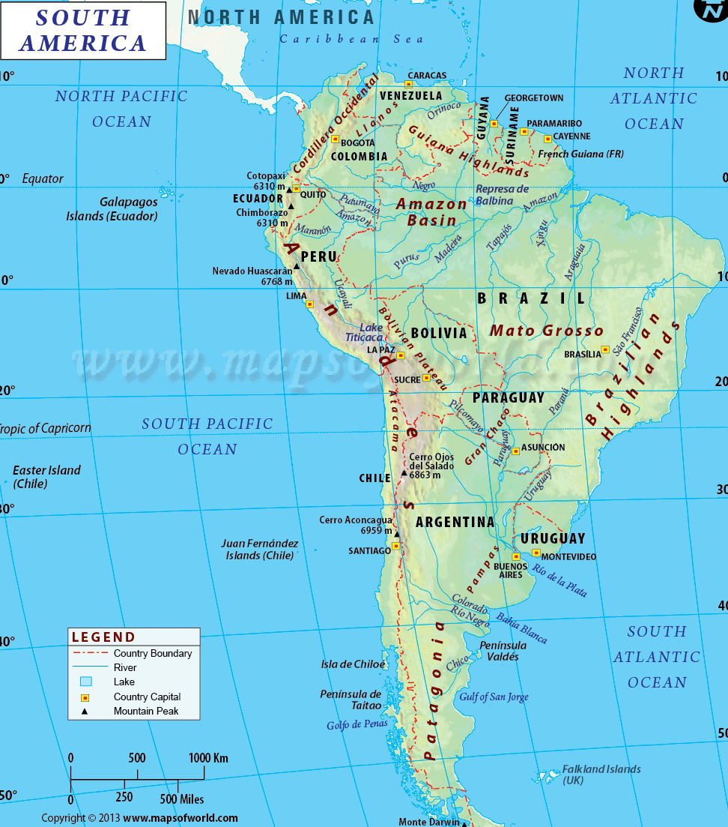
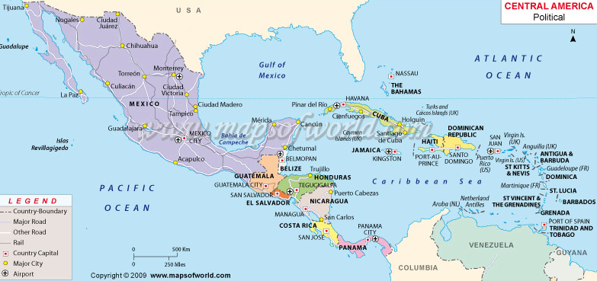
Regina Bousso szylit@usp.br
South America
Central America
Portugal and Spain
Regional Breakdown

Slide 13
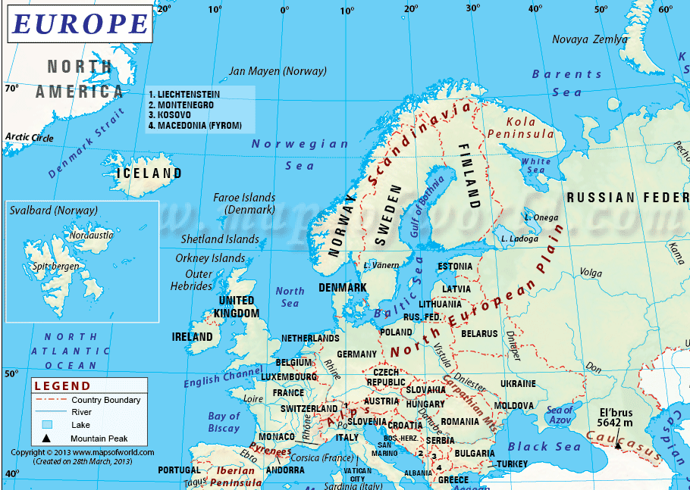
Veronica Swallow
veronica.swallow@manchester.ac.uk
Europe (except Portugal & Spain)
Regional Breakdown

Slide 14
Strategies for Disseminating Who?
Colleagues in your organization e.g.
Research Director/s
Programme Director/s
Deans/Associate Dean/s Research/Education
Person doing your performance review
Collaborators
Colleagues outside your organization e.g.
Practice collaborators
Collaborators in other universities/ colleges
National/international networks
PhD & Masters students
Local professional organizations (e.g., STT chapter)
Notes:
We each know what works best in our own country and within our own national and international networks, these are some examples but please modify as needed to fit your country/networks.
INTERNAL: For example please share the IFNA conference promotional material widely with colleagues in your own organization e.g. Research Directors, Programme Directors, Deans/Associate Deans for Research/Education, the colleague who undertakes your regular appraisal/performance review, the person responsible for allocating funds for conference attendance in your organization. Current PG students may have funding for dissemination/conference attendance within their research award or fellowship to enable them to attend IFNA to present their research. And your colleagues who do relevant research may have funds within their current research grants for dissemination but may not be aware of the IFNA conference unless you mention it.
EXTERNAL: we can all share the promotional material widely with colleagues outside our organizations, such as Nurse leaders, Heads of Nursing, Associate Deans for Research/Education, family centered care (or your local equivalent) Services Leaders. and your and your colleagues’ current and past post-graduate students (PhD & Masters) researching in this area and even those whose projects you may have examined. Local professional organizations (e.g., STT chapter)

Slide 15
Strategies for Disseminating (How ?) 1
Word of mouth
Email distribution lists
Websites e.g. your university or hospital site
Newsletters e.g. University or Hospital Research updates
At conferences/meetings
Use IFNA promotional material
Begin seeking funding ASAP
Notes:
We each may have day to day opportunities to share information about the IFNA conference by word of mouth as well as via any relevant distribution lists us or our colleagues (in and outside our organizations) are aware of, so lets mention it at meetings, tell colleagues informally, think of all the email distribution lists we are signed up to and ask if we can share the IFNA material via those that are relevant,
Same for newsletters we regularly receive, we could find out who coordinates/edits/administers them and ask if the conference material can be included at the earliest opportunity; ask colleagues to do the same in their relevant networks.
Social Media……..some people are more familiar with these than others but if using these we can capitalise on the opportunities these present as a way of flagging the IFNA conference. urge your constituents /colleagues to begin seeking funding ASAP

Slide 16
Strategies for Disseminating (How ?) 2
Social media (e.g. IFNA online Family Nursing Community, Twitter, Facebook, Instagram, LinkedIn)
Online Family Nursing Community within the IFNA website: http://internationalfamilynursing.org/online-community/ which includes Forums that can be established for any topic and the Online Family Nursing Profile that each member is invited to develop to feature their areas of expertise and websites. Liaisons are encouraged to create their own profile.
IFNA Twitter
https://twitter.com/IFNAorg , Use #familynursing
LinkedIn - https://www.linkedin.com/groups/International-Family-Nursing-Association-6664854?home=&gid=6664854&trk=anet_ug_hm&goback=%2Eanp_6664854_1408027147193_1
IFNA Listserv - The email address for the IFNA Listserv is: international-family-nursing-association@googlegroups.com
Notes:
Other conferences we are attending in the near future can provide a ‘captive audience’ for us to publicise the IFNA conference.
Use promotional materials that are available in English with P.Point slide and pdf to email.
Conference organisers often have tables near the registration area where promotional materials can be placed, conferences now often have twitter discussion ongoing during the conference, if attending a conference session that is relevant to family nursing, perhaps ask the speaker beforehand (if there is an opportunity) if you could circulate information about the IFNA conference after their talk, or leave leaflets on the seats. So we can capitalise on these opportunities.
Begin seeking funding ASAP (this may have been discussed earlier in which case ill omit here – or just reinforce?)

Slide 17
Are you or someone you know interested in being a Country Liaison?
Please contact one of the following:
Regina Bousso - szylit@usp.br
Veronica Swallow - veronica.swallow@manchester.ac.uk
Jane Lassetter – jane_lassetter@byu.edu

